Slide 1
Mediarhetoric
13.10.2020

Slide 2
Ethics in Public Speaking

Slide 3
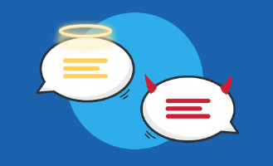
What?! Ethics??
At its simplest, ethics is a system of moral principles.
Ethics is concerned with what is good for individuals and society and is also described as moral philosophy. The term is derived from the Greek word ethos which can mean custom, habit, character or disposition.

Slide 4
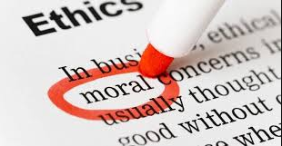
To Aristotle, ethics is an obligation in public rhetoric or public speaking.
Ethical responsibility is essential to any communication act, particularly when speaking to a public. When deciding to speak to an audience, you must be guided by what you consider right or wrong in an effort to be effective.

Slide 5
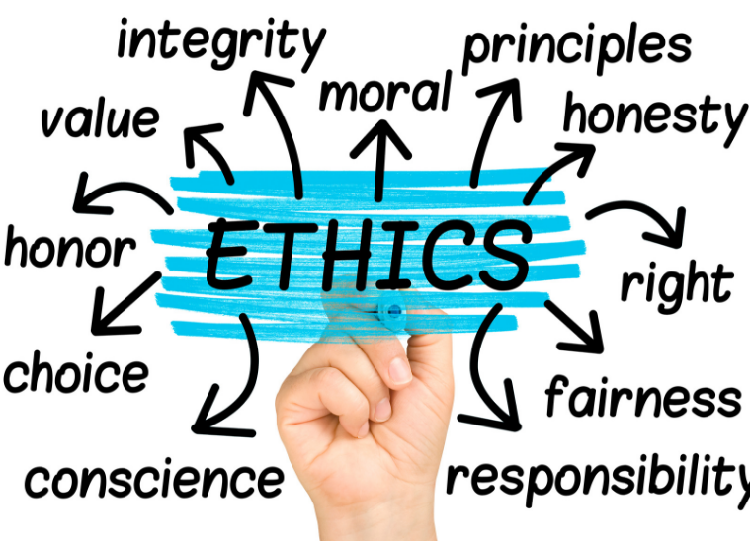
What is unethical speech?

Slide 6
!!!
To speak ethically is to use your own original speech content. If you use any substantiating facts or passages from another, you must give appropriate attribution or credit as necessary. Ethical speakers are ones who do not plagiarize their material or try to pass off words and ideas from others as their own.

Slide 7
Why do you need to be ethical?
To keep your reputation
To present accurate (true) arguments
To abide shared goals and values

Slide 8
Rules of ethical speech
Ethical Goals
Preparation
Honesty
Non-Abusive Language

Slide 9
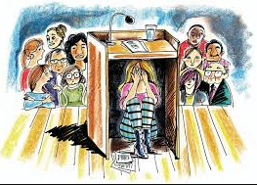
Fear of Public Speaking

Slide 10
Glossophobia
Glossophobia or speech anxiety is the fear of public speaking. The word glossophobia derives from the Greek γλῶσσα glōssa, meaning tongue, and φόβος phobos, fear or dread. Some people have this specific phobia, while others may also have broader social phobia or social anxiety disorder.

Slide 11
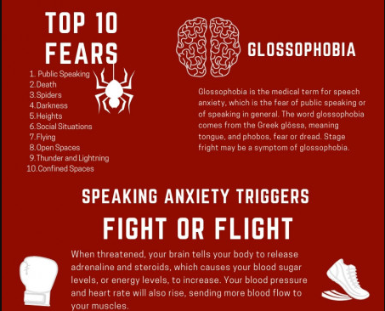

Slide 12
